Slide 1
How to do a Pose Prediction project?
22.10.2020
Car Pose Estimation using the CenterNet NN architecture

Slide 2
Peking University/Baidu - Autonomous Driving Challenge
Kaggle competition
Goal: Car Pose Estimation: Predict car 3D coordinates + rotations(yaw, roll, pitch)
How: Train a model on the ApolloCar3D dataset
My assignment is based on a great baseline from the competition notebooks: https://www.kaggle.com/hocop1/centernet-baseline

Slide 3
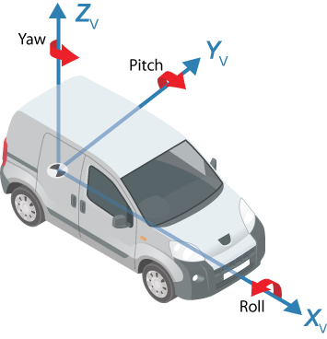
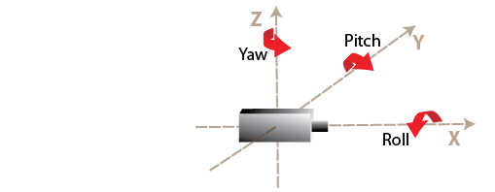
Car Pose Estimation: Predict car 3D coordinates + rotations(yaw, roll, pitch)
https://www.mathworks.com/help/driving/ug/coordinate-systems.html

Slide 4
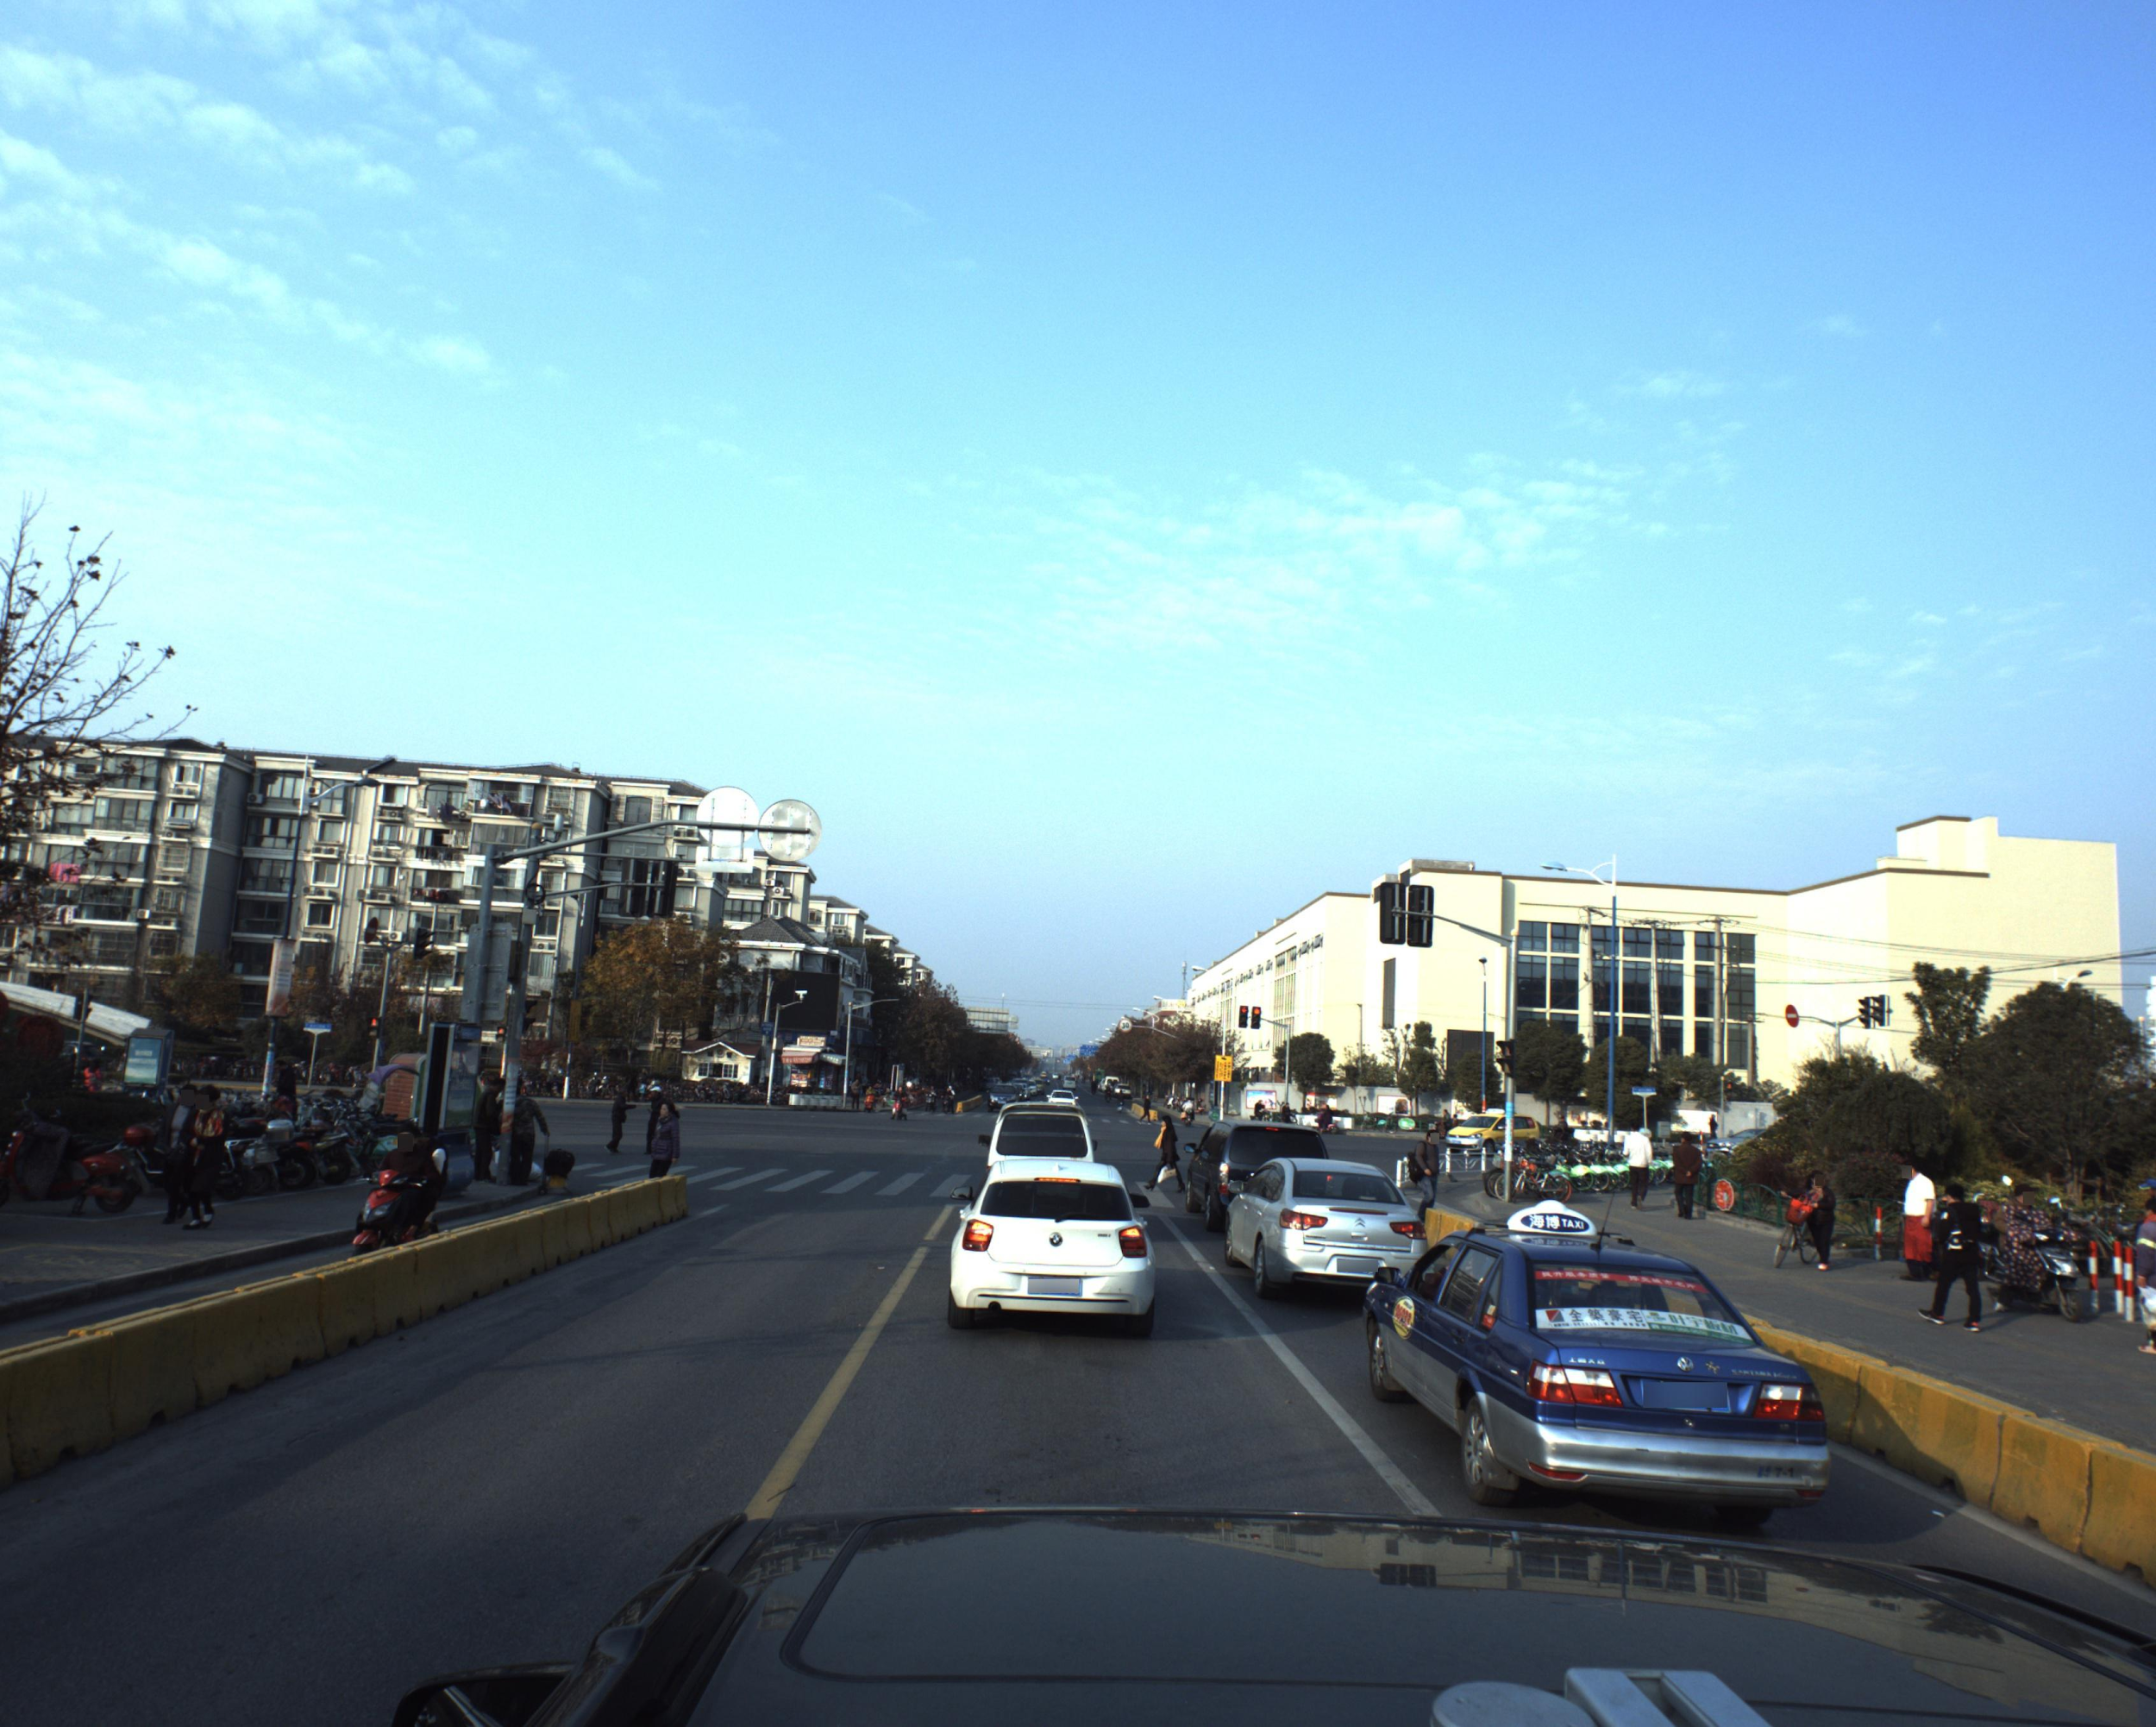
Challenge targets
Car1: yaw,x,y,z
Car2: yaw,x,y,z
Car3: yaw,x,y,z
Car4: yaw,x,y,z

Slide 5
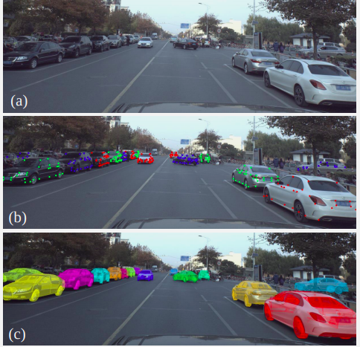
ApolloCar3D dataset
~5000 images sampled from the Apolloscape dataset to represent a diverse set of translations, rotations and occlusions
Enables filtering by occlusions
Sensors: 4 cameras (2 included in dataset), and 2 lidars.

Slide 6
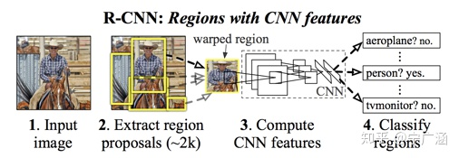
Choosing an Architecture:
Two-stage vs One-stage detectors
Two-Stage
source: https://zhuanlan.zhihu.com/p/146219600

Slide 7
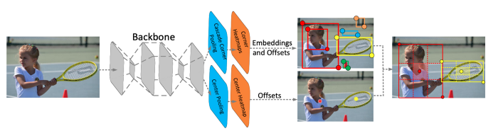
Choosing an Architecture:
Two-stage vs One-stage detectors
One-Stage

Slide 8
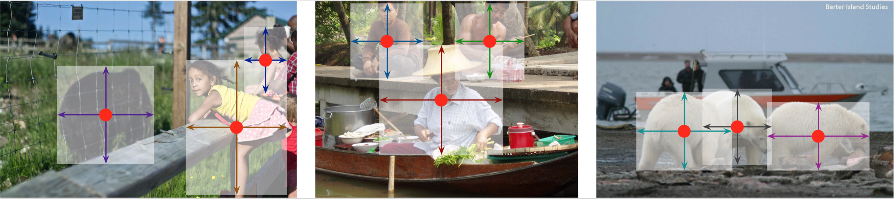
CenterNet - Objects As Points
One stage
Direct heatmap regression(No Anchors)
No NMS
Balances speed and accuracy
Easily adjustable to many uses(detection, semantic segmentation, keypoint estimation, pose estimation)

Slide 9
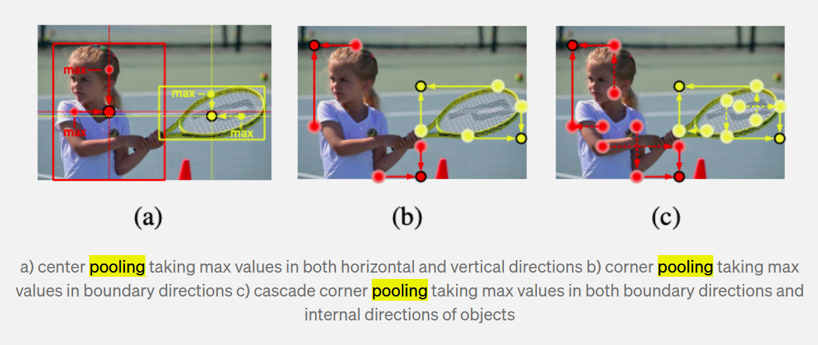
Center Pooling
Source: https://towardsdatascience.com/centernet-keypoint-triplets-for-object-detection-review-a314a8e4d4b0

Slide 10
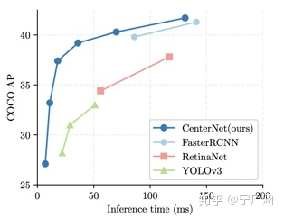
Speed Accuracy Balance

Slide 11
Challenge targets
Car1: yaw,x,y,z
Car2: yaw,x,y,z
Car3: yaw,x,y,z
Car4: yaw,x,y,z

Slide 12
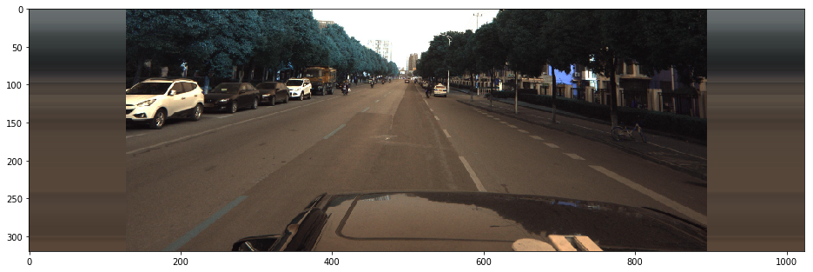
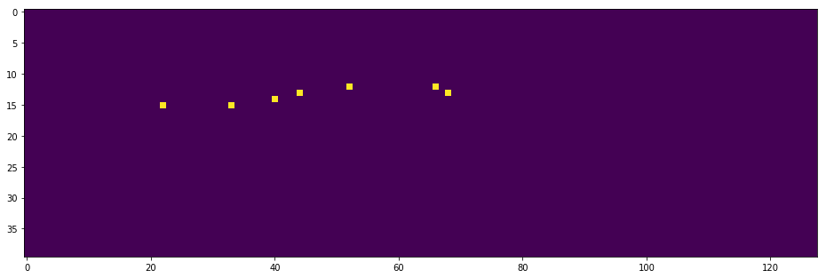
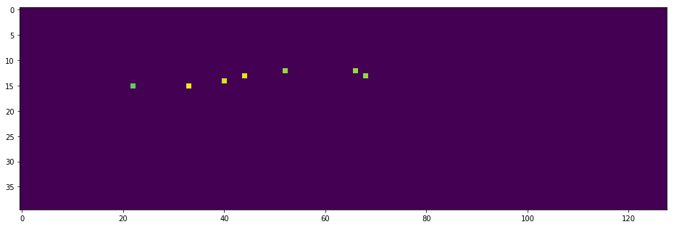
Input and prediction targets for CenterNet
Input image
Centers mask
Yaw values
Source: https://www.kaggle.com/hocop1/centernet-baseline

Slide 13
Challenges to tackle in the original solution
No Busses
Generalization to other cameras and scenes
Optimizing speed
How:
Train on the Lyft Dataset
Replace network backbone with MobileNet

Slide 14
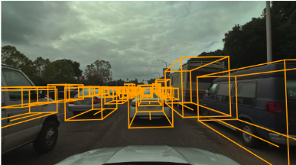
Lyft Dataset
Sensors: 7 cameras, and 3 lidars
Includes 180 scenes x 28 seconds x 5 fps synchronized camera, and lidar measurements from 10–20 different drives
I sampled every 3rd image, 8400 samples

Slide 15
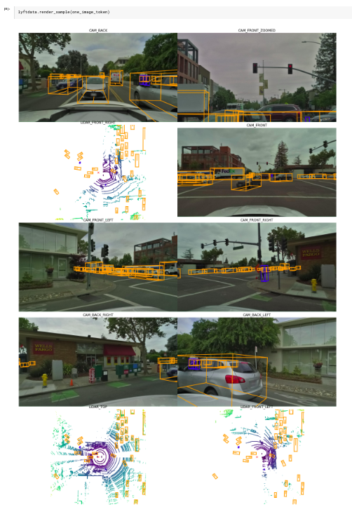
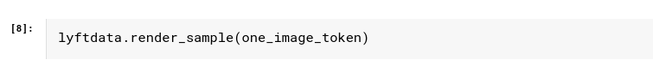
Extracting data from the dataset

Slide 16
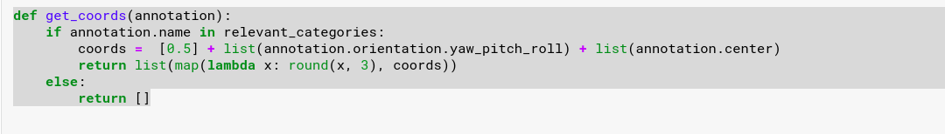
Extracting data from the dataset

Slide 17
Results
MobileNet degraded the model performance and didn’t improve the inference time significantly.

Slide 18
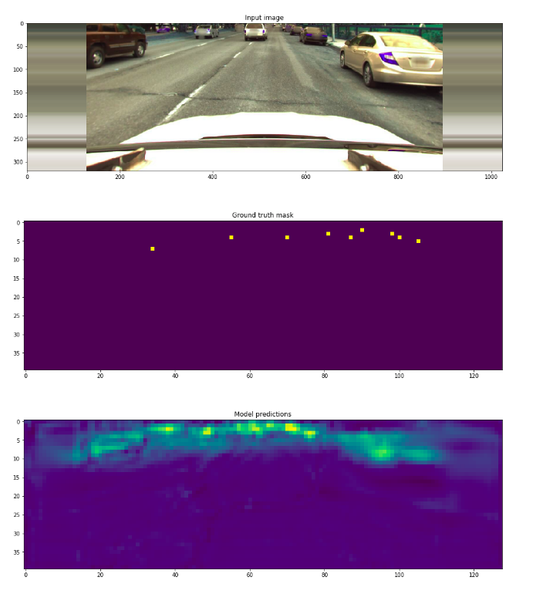
Results
Training on Lyft:

Slide 19
Thank you for your attention

